Slide 1
WEB & Mobile Application development
Module – 02
JS Class 03
Saylani Mass IT Training Faisalabad
Instructor : Umair Azmat
WhatsApp : +923217061116

Slide 2
JS Syntax
Statements are syntax constructs and commands that perform actions.
We’ve already seen a statement, alert('Hello, world!'), which shows the message “Hello, world!”.
We can have as many statements in our code as we want. Statements can be separated with a semicolon.
For example, here we split “Hello World” into two alerts:
alert('Hello'); alert('World');
Usually, statements are written on separate lines to make the code more readable:
alert('Hello');
alert('World');

Slide 3
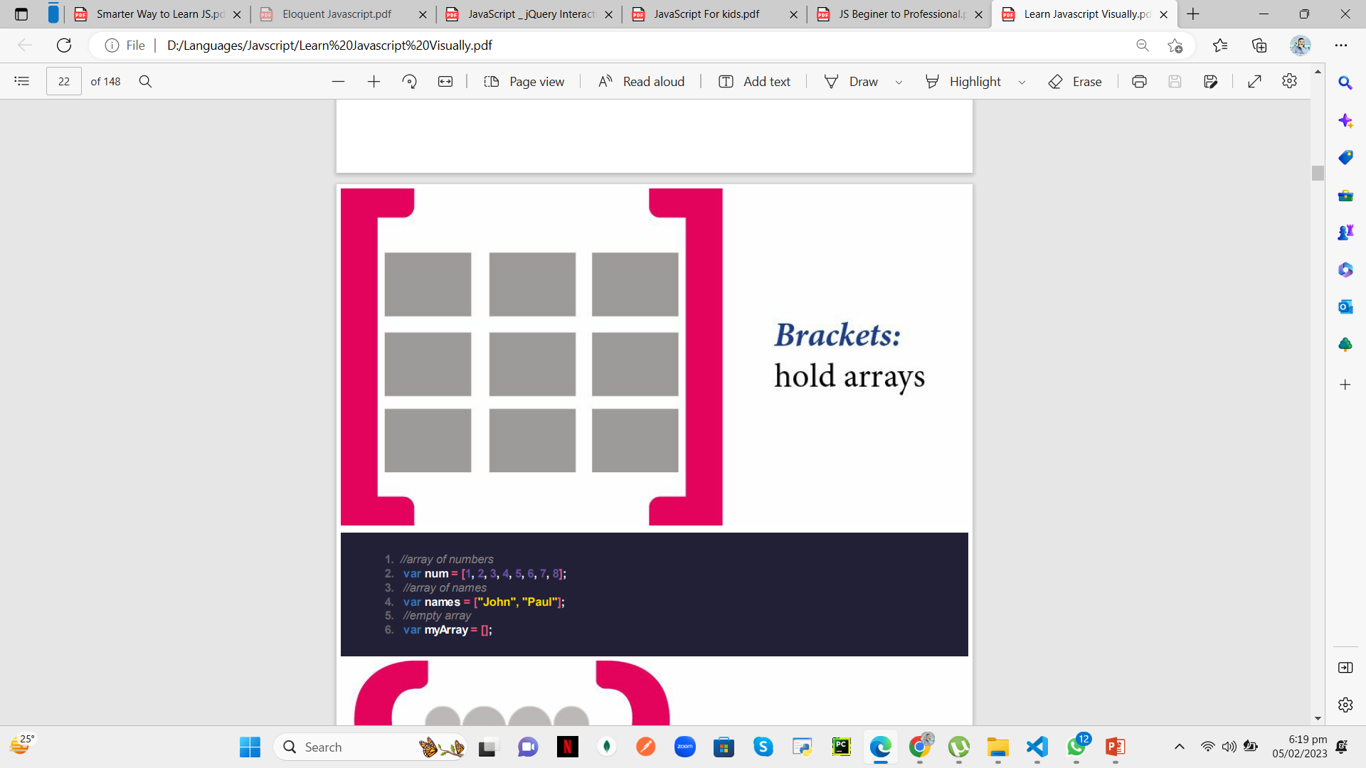
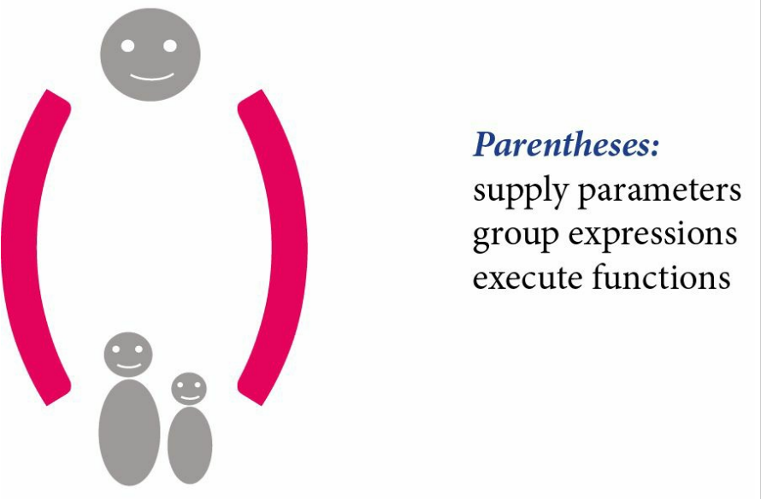
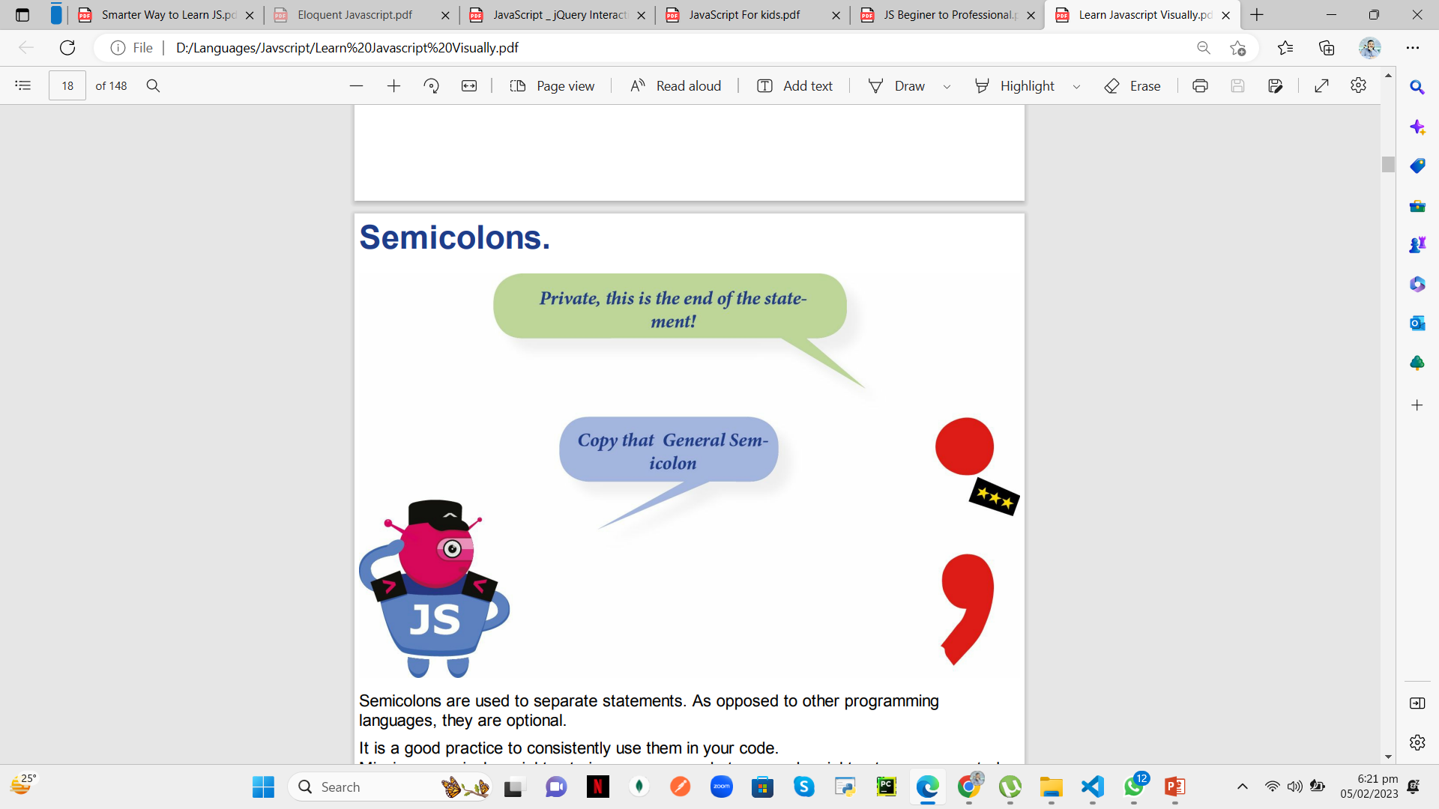
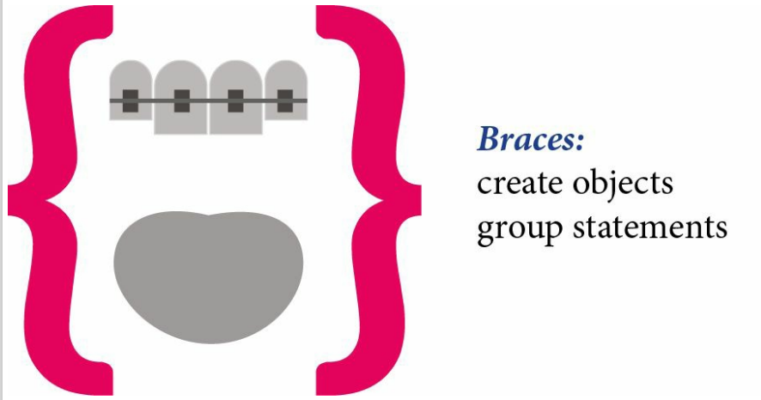

Slide 4
JS Comment
As time goes on, programs become more and more complex. It becomes necessary to add comments which describe what the code does and why.
One-line comments start with two forward slash characters //.
The rest of the line is a comment. It may occupy a full line of its own or follow a statement.
Like here:
// This comment occupies a line of its own
alert('Hello');
Multiline comments start with a forward slash and an asterisk /* and end with an asterisk and a forward slash */.
Like this:
/* An example with two messages.
This is a multiline comment.
*/

Slide 5
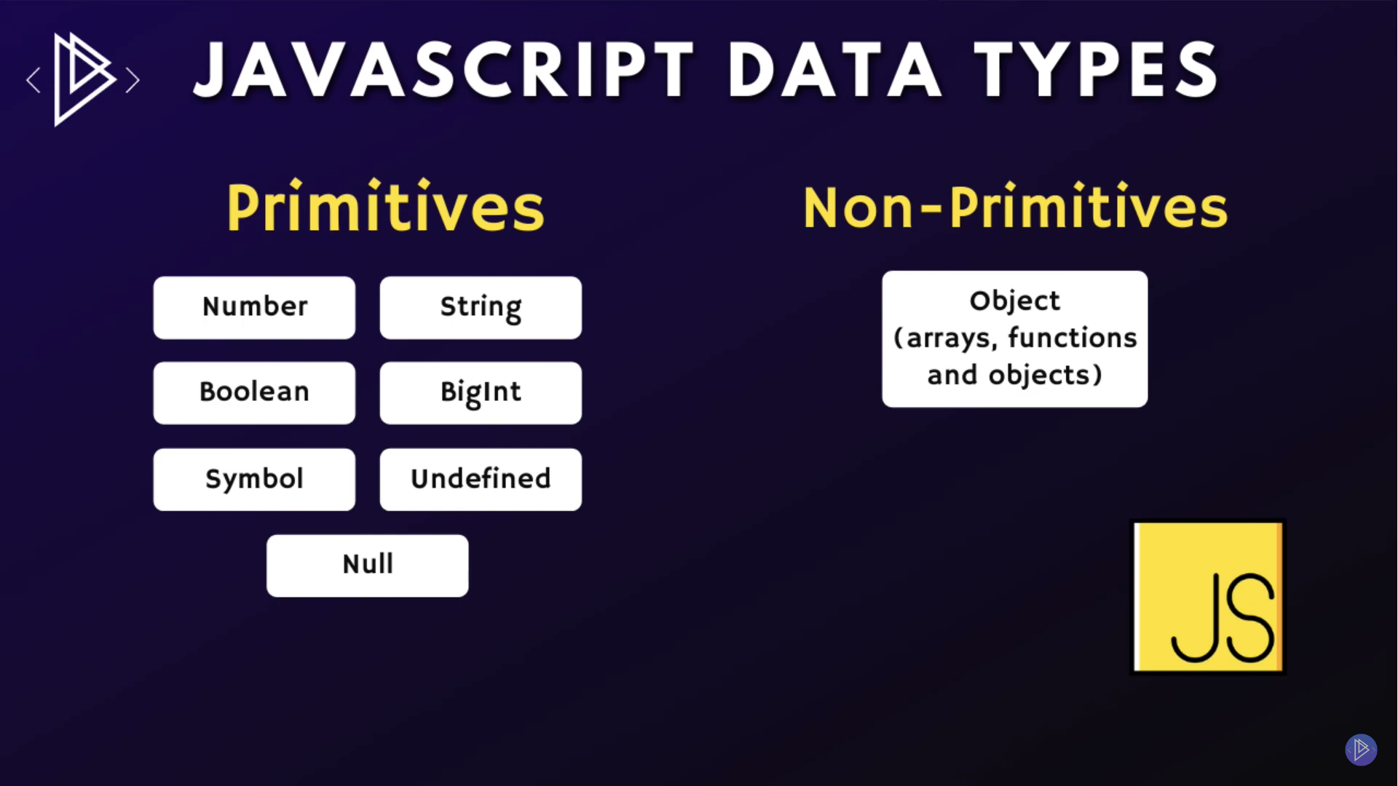
JS Data Types

Slide 6
Primitive vs Non-Prmitive
Feature | Primitive Data Types | Non-Primitive Data Types
Stored value | Directly stored | Stored as a reference
Memory allocation | Fixed size | Dynamic size
Equality comparison | By value | By reference
Pass-by value or reference | Pass-by value | Pass-by reference
Methods | None | Have methods

Slide 7
Primitive vs Non-Primitive
Primitive (fundamental) data types in JavaScript include:
Number: Used for numeric values, e.g. 42 or 3.14.
String: Used for text values, e.g. "Hello, World!" or "42".
Boolean: Used for true/false values, e.g. true or false.
Undefined: Used to represent a variable that has been declared but has not been assigned a value, e.g. let x; console.log(x); // outputs: undefined
Null: Used to represent the intentional absence of any object value, e.g. let x = null; console.log(x); // outputs: null
Symbol: Used to create unique identifiers for objects.
BigInt: for large number e.g let number = 1212122312313N;
Non-primitive (object) data types in JavaScript include
Object: Used to store collections of data and more complex entities, e.g. let car = {type: "sedan", make: "Toyota", model: "Camry"};
Array: Used to store ordered collections of values, e.g. let numbers = [1, 2, 3, 4, 5];
Function: Used to store a piece of code that can be executed, e.g. function add(a, b) {return a + b;}
Date: Used to store and manipulate date and time values, e.g. let date = new Date();
RegExp: Used to store regular expressions, e.g. let pattern = /\d+/;

Slide 8
Variables
We can easily grasp the concept of a “variable” if we imagine it as a “box” for data, with a uniquely-named sticker on it.
For instance, the variable message can be imagined as a box labeled "message" with the value "Hello!" in it:
We can put any value in the box.
camelCase
We can also change it as many times as we want:
let message;
message = 'Hello!';
message = 'World!'; // value changed
alert(message);

Slide 9
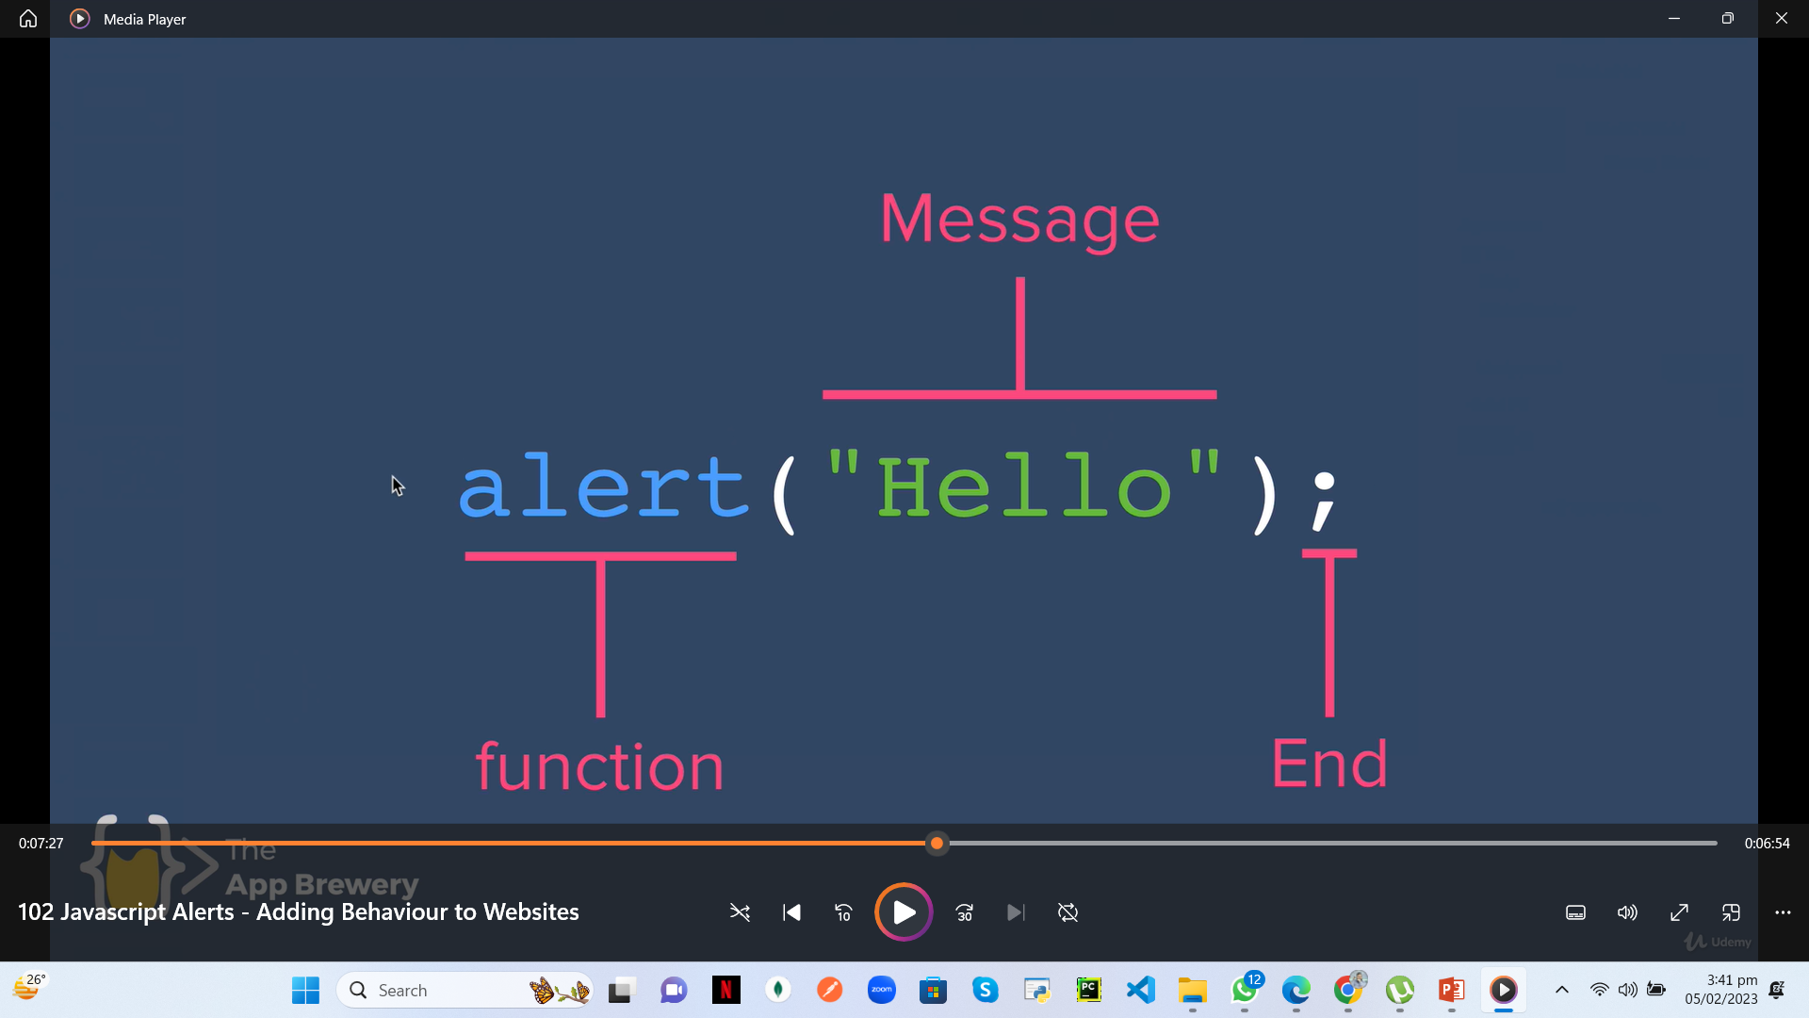
Alert Function

Slide 10
Constants
To declare a constant (unchanging) variable, use const instead of let:
const myBirthday = '18.04.1982';
Variables declared using const are called “constants”. They cannot be reassigned. An attempt to do so would cause an error:
const myBirthday = '18.04.1982';
myBirthday = '01.01.2001'; // error, can't reassign the constant!
When a programmer is sure that a variable will never change, they can declare it with const to guarantee and clearly communicate that fact to everyone.

Slide 11
Rules for naming Variable
Variables names must start with a letter, underscore (_), or dollar sign ($).
Right example: let myVariable
Wrong example: let 123Variable
Variables names can only contain letters, numbers, underscores (_), or dollar signs ($).
Right example: let myVariable_123
Wrong example: let myVariable-123
Variable names cannot be a reserved word in JavaScript, such as let, for, if, etc.
Right example: let myVariable
Wrong example: let let

Slide 12
Rules for naming Variable
Variable names should be descriptive and meaningful.
Right example: let userName
Wrong example: let x
Variable names should not contain spaces or special characters other than underscore (_) or dollar sign ($).
Right example: let user_name
Wrong example: let user name
Variable names should be written in camelCase or snake_case, but not in PascalCase.
Right example: let userName or let user_name
Wrong example: let UserName

Slide 13
Rules for naming Variable
vriable names should be concise, but not too short.
Right example: let firstName
Wrong example: let fn
It's a good practice to follow these rules in order to write clean and maintainable code.
let 123name = "Umair Azmat"; // Error var name can not start with number
let -124name = "Umair Azmat"; // Error var name can not start with special character
let function = 5.6; // Error var name can not be a keyword
let my name = "Umair Azmat"; // Error var name can not have space
let my-name = "Umair Azmat"; // Error var name can not have special character

Slide 14
Summary of Variables
We can declare variables to store data by using the var, let, or const keywords.
let – is a modern variable declaration.
var – is an old-school variable declaration. Normally we don’t use it at all, but we’ll cover subtle differences from let in the chapter The old "var", just in case you need them.
const – is like let, but the value of the variable can’t be changed.
Variables should be named in a way that allows us to easily understand what’s inside them.

Slide 15
Get Output
Alert
alert(“Hello world”);
Prompt
console.log(prompt("Enter Your Name", "Umair Azmat"));
Confirm
console.log(confirm("Are You Sure?"));
Console
console.log(“”);
console.warn
console.error
console.info

Slide 16
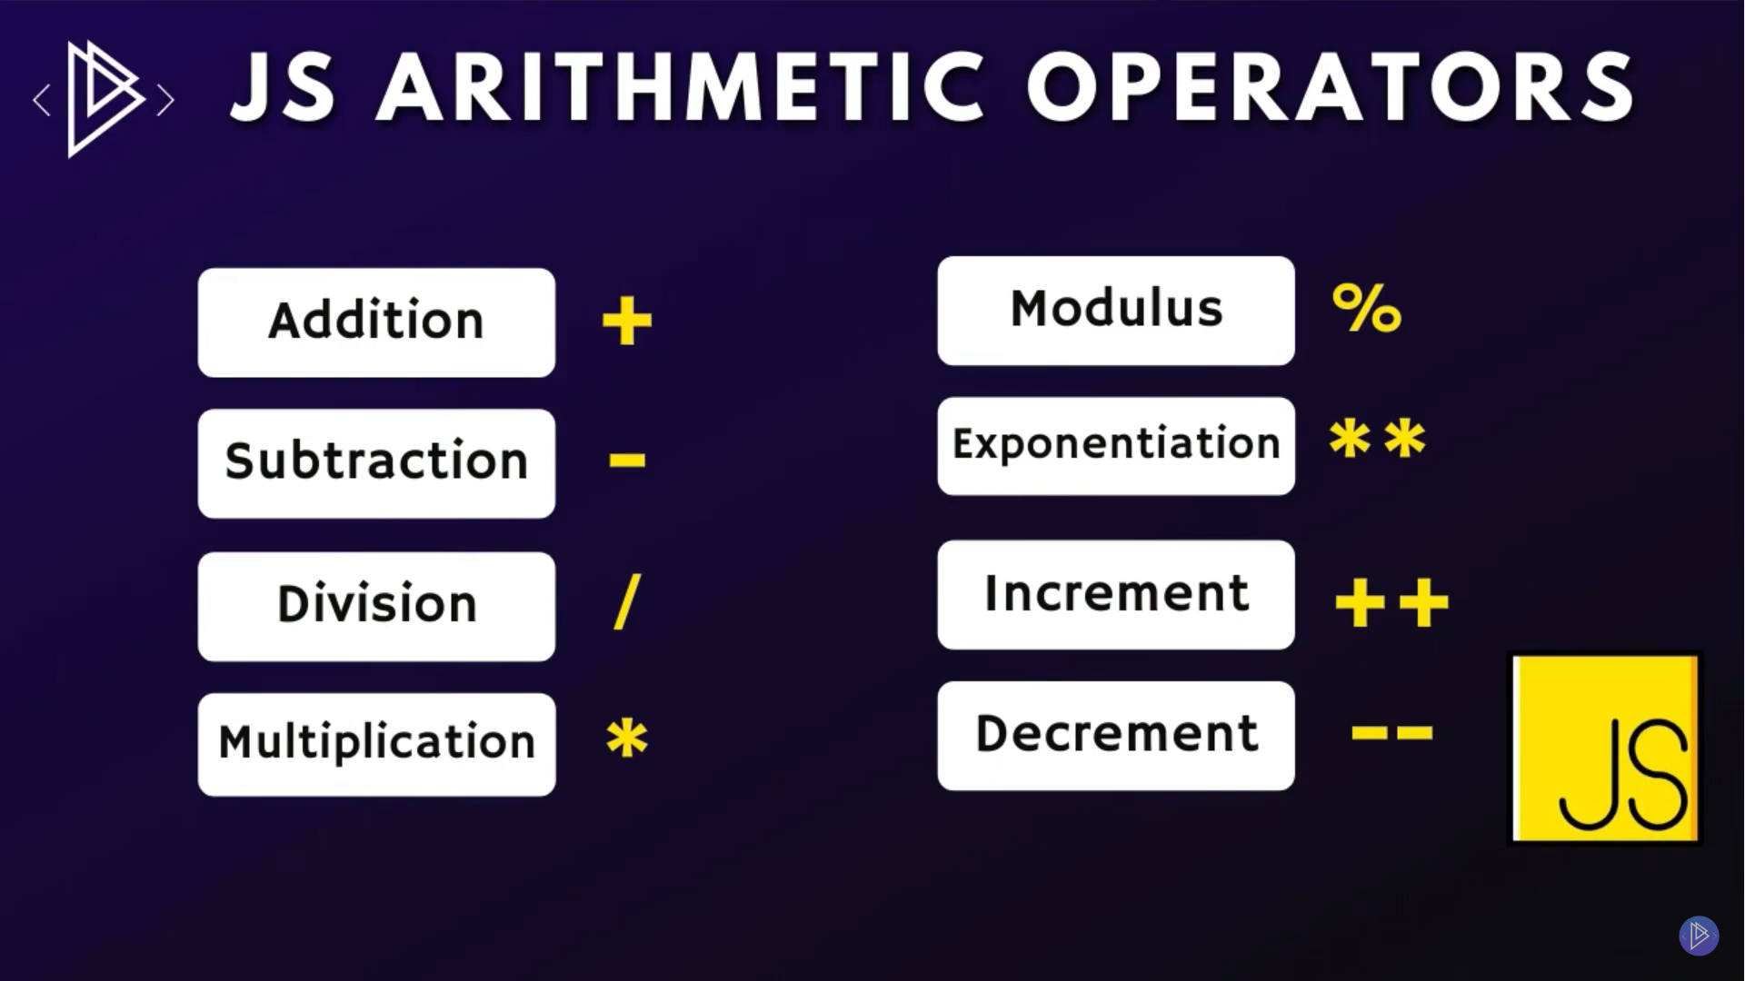
Arithmetic Operators
BODMAS

Slide 17
Thanks!
Do you have any questions?
umairazmat8115@gmail.com
+923217061116 umairazmat.me

